Slide 1
Lecture 1: Moore’s Law and Beyond

Slide 2
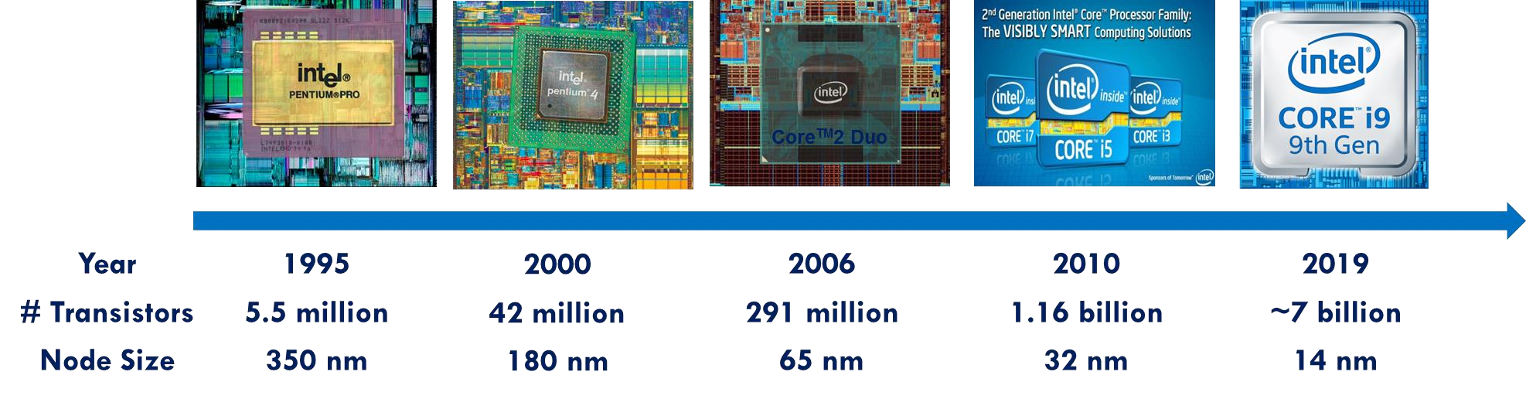

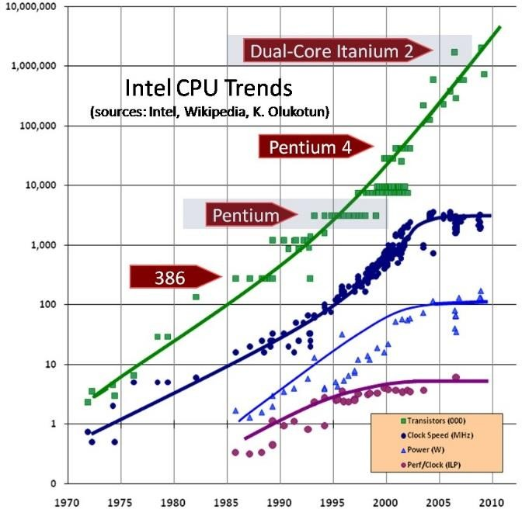
Moore’s Law
Power
Frequency

Slide 3
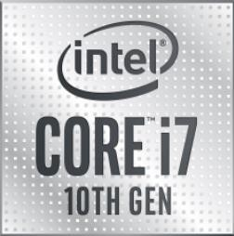
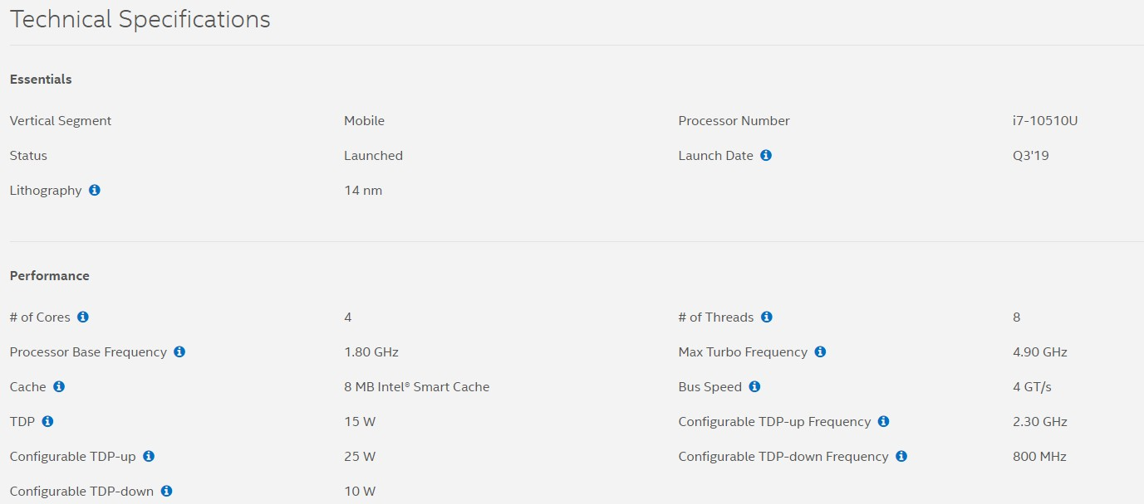
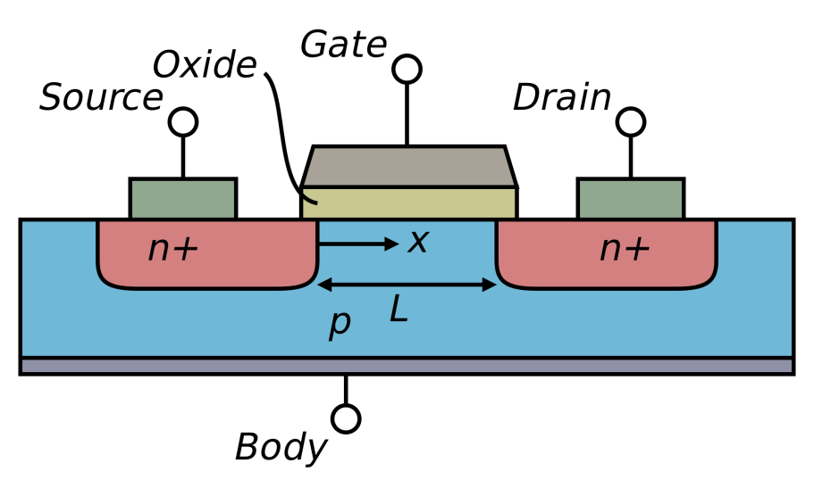
10th Gen. Intel Processor
f ~ ¹ = ^{vS}
T
t L
Transistor is not the speed limiting factor!
10⁶ cm / s
~
3
= 10 GHz
10 nm

Slide 4
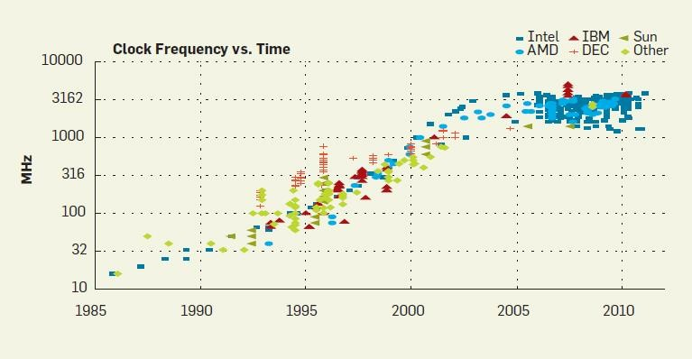

Speed Limit and Power Dissipation on the Device Level
100
Sub-threshold Leakage
Gate Length
1
Dynamic
Power
0.01
Gate Leakage with high-k
0.0001
0.000001
1990 1995 2000 2005 2010 2015 2020
Dynamic Power
P ∝ N⋅CV²f
Static Power
Tunneling between S/D
Dark Silicon Effect (暗硅效应)- 5%
For a 4 cm² chip, assume V_{dd} = 0.6V and f = 10GHz, then the total dynamic power dissipation is 4kW
If the power budget is 200 W — This means only 5% transistors can be switched at the same time
Sub-threshold Leakage
Gate leakage

Slide 5
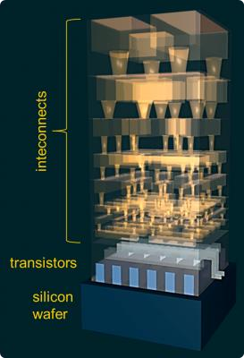
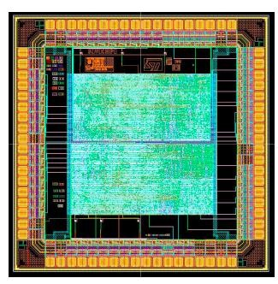
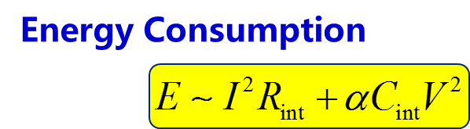
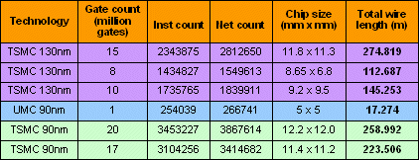
Speed Limit and Power Dissipation on the Interconnect Level
Propagation Delay
t _{p} ~ 0.69RC
Total wire length
~ 100 m

Slide 6
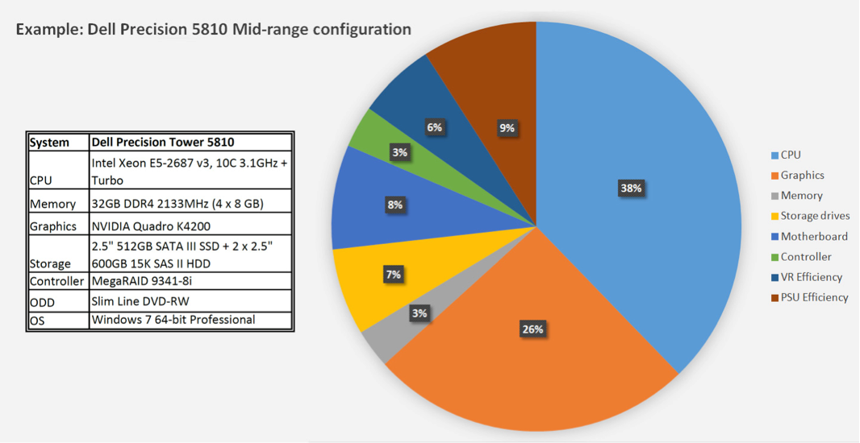
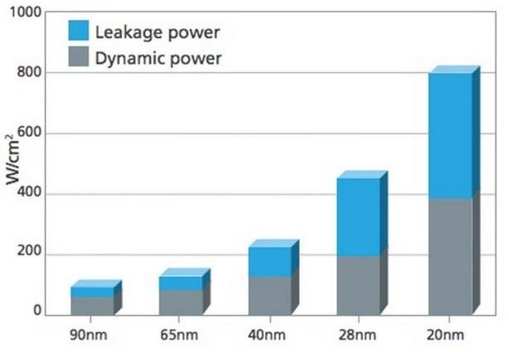
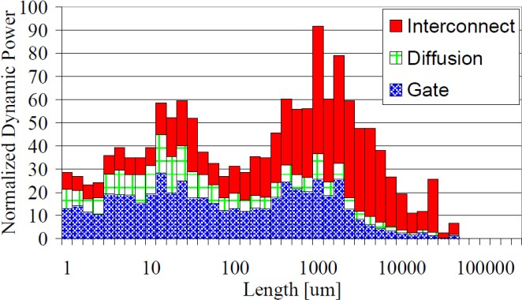
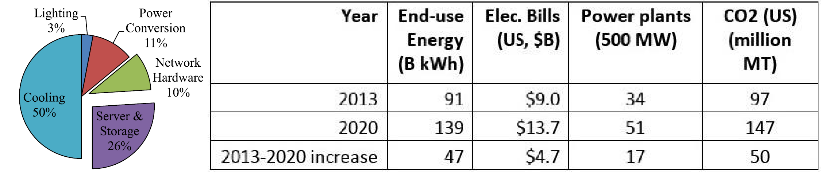
Computer Power Dissipation
PC
https://semiengineering.com/as-nodes- advance-so-must-power-analysis/
N. Magen et al. SLIP’04
Data Center
M. Dayarathna et al. IEEE Communications Surveys & Tutorials (2016)

Slide 7
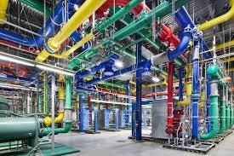
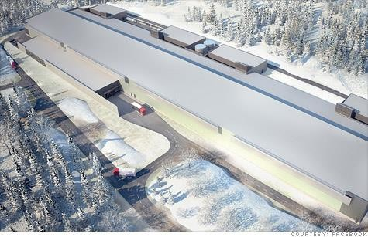
Tsunami of Data Era has Come!
Over 2.5 billion computers in the world
1 PW (10¹⁵ W) of power dissipation
Equivalent to 160 nuclear plants!
'Tsunami of data' could consume one fifth of global electricity by 2025!
Google Data Center
Facebook Data Center @ Sweden

Slide 8
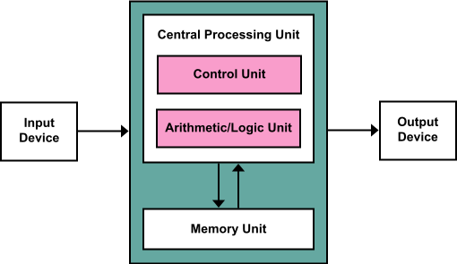
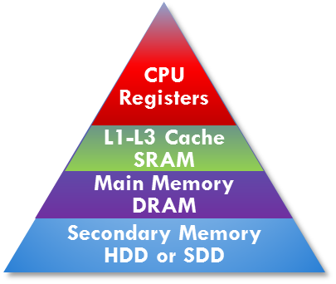
Computer Speed – Von Neumann’s Limit
A[12] = h + A[8]
Von Neumann architecture Memory Hierarchy
Bottleneck: The shared bus between the program memory and data memory limits throughput (data transfer rate) between the CPU and memory!
Data transfer rate Limitations
Propagation Delay
t _{p} ~ 0.69RC
Shannon–Hartley theorem C = B log (1+ ^{S} )
2
N

Slide 9
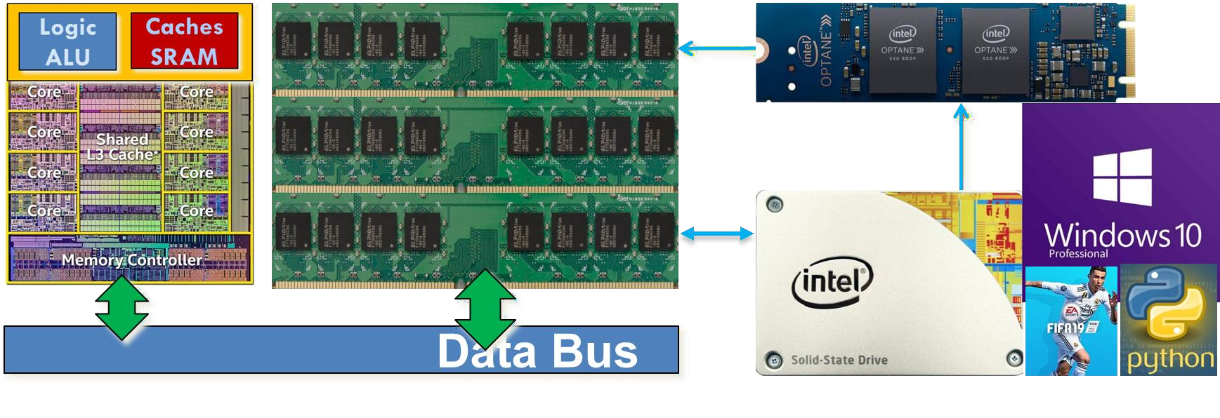
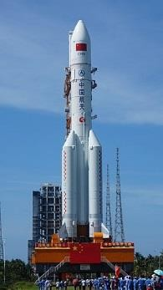
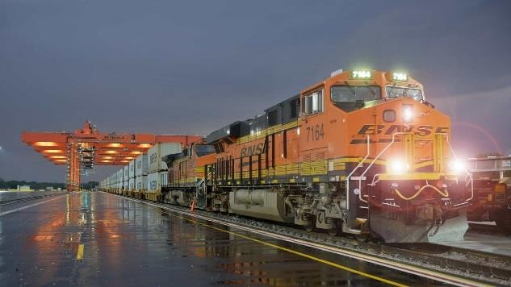

Computer Speed – Von Neumann’s Limit
1~10 fJ/bit
< 1 ns Mb
10,000 fJ/bit
10 ~ 100 ns
1,000 Mb
100,000 fJ/bit 10,000~100,000 ns
1,000,000 Mb
1000~100,000 fJ/bit

Slide 10
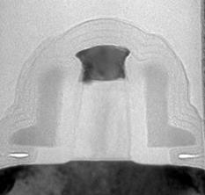
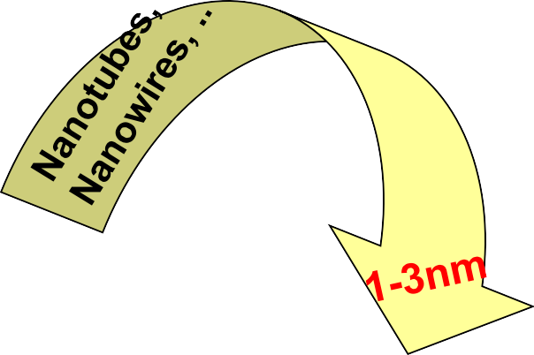
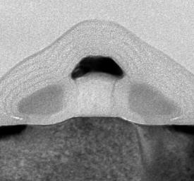
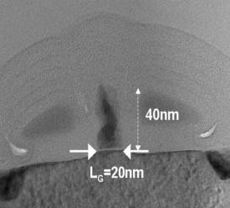
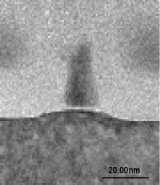
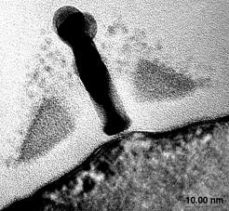
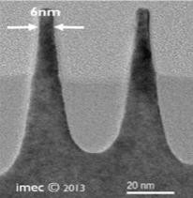









Future Trend: CMOS Device Scaling
90nm Node
2003
65nm Node 2005
45nm Node
2007
32nm Node
2009
50nm Length
22nm Node 2011
(IEDM2002)
30nm
25 nm
14 nm node
2013
Prototype (IEDM2000)
20nm Prototype (VLSI2001)
15nm
10nm node
15nm Prototype
(IEDM2001)
2015
7 nm node
2019
Limit ~ 3-5 nm
10nm Prototype
7nm Prototype
(DRC 2003)
Nanowires/tubes and others Si CMOS becoming less Si
(IMEC 2013)
5nm
3nm
Monolithic Heterogeneous integration

Slide 11
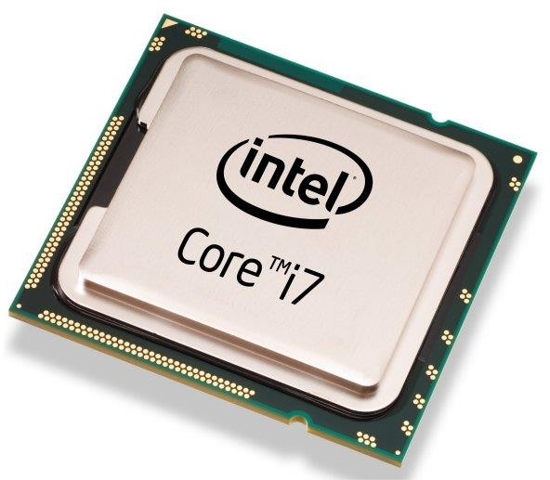
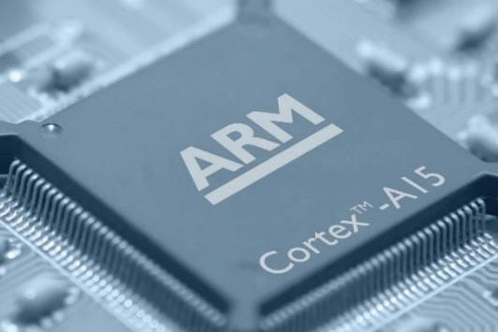
Future Trend: Architecture Design
Speed and Power CANNOT be optimized simultaneously!
speed/area speed
speed/power variation
speed/ power
area
power
low power ultra-low power variation
1970’s
1980’s
1990’s
2000’s
2010’s

Slide 12
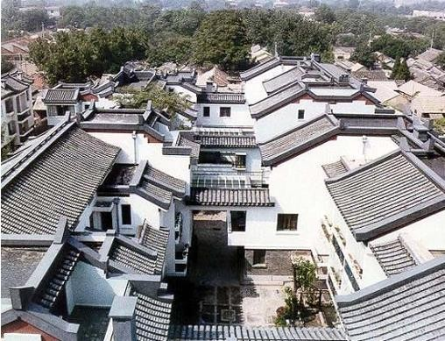
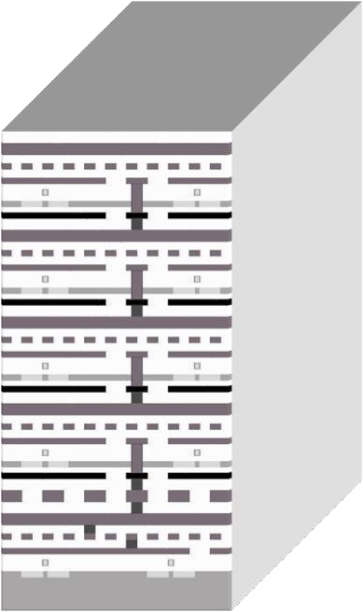

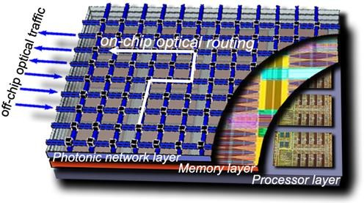


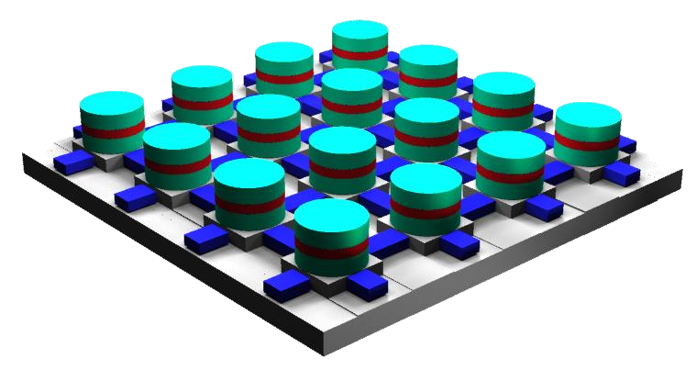





Future Trend: 3D IC Technology
Layer 5
Layer 4
Interlayer Via
(TSVs)
Metal wires of layer 1
Device on layer 1
Layer 3
MTJ Unit
Layer 2
Layer 1
Bulk Substrate
[www.tourtx.cn]
3D chip
CMOS
Peripheral
Spin-based logic operations
Multifunction Chip
Higher packing density, faster on-chip communication.
Also higher power density and more severe heat issue.

Slide 13
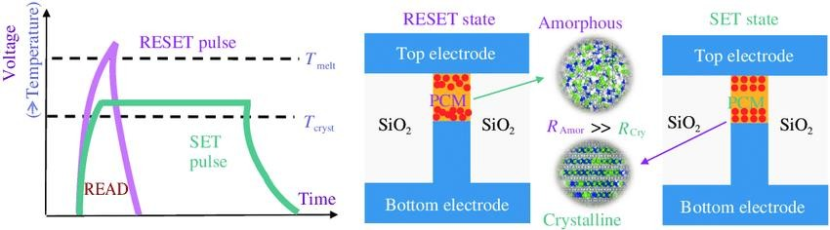
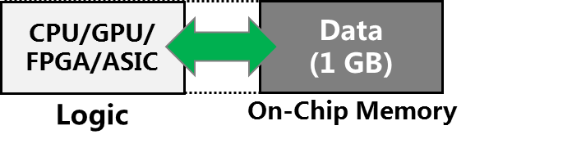

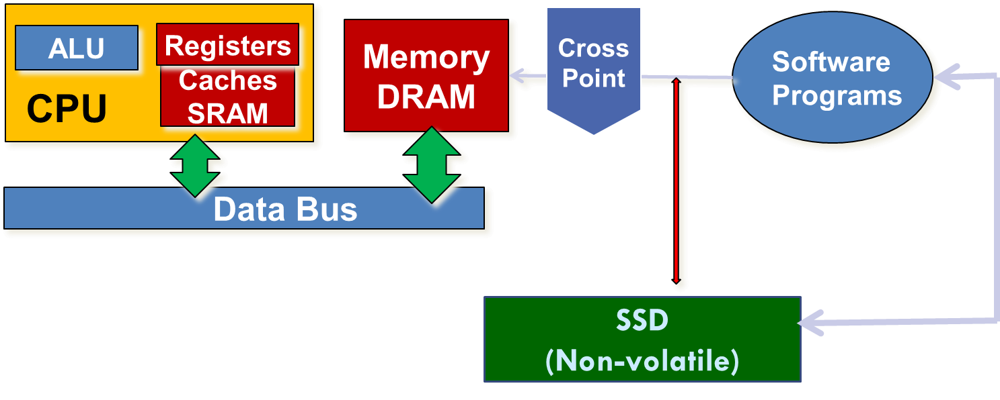
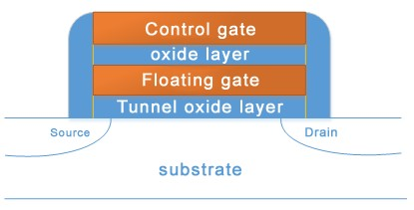
Future Trend: Emerging Non-Volatile Memories
Phase-Change RAM (PCRAM)
Neuromorphic
Technology | Flash | 3D XPoint | MRAM
Endurance (Cycles) | 10⁵ | ~10⁸ | ₁₀15
Write Speed (ns) | 100,000 | 100 | 1 – 10
Read Speed (ns) | 10,000 | 100 | 1 – 10
Cell size (area in F²) | 2 – 4 | 2 – 4 | 4 – 40
Energy/bit (fJ) | 1,000,000 | > 1000 | 1 – 1000
Flash Memory

Slide 14
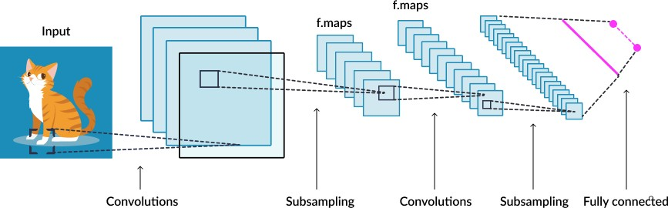
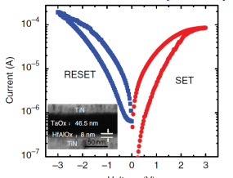
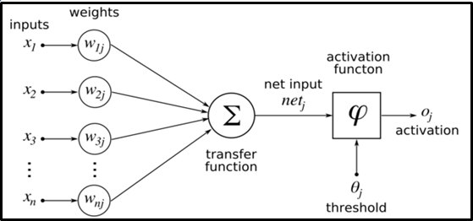
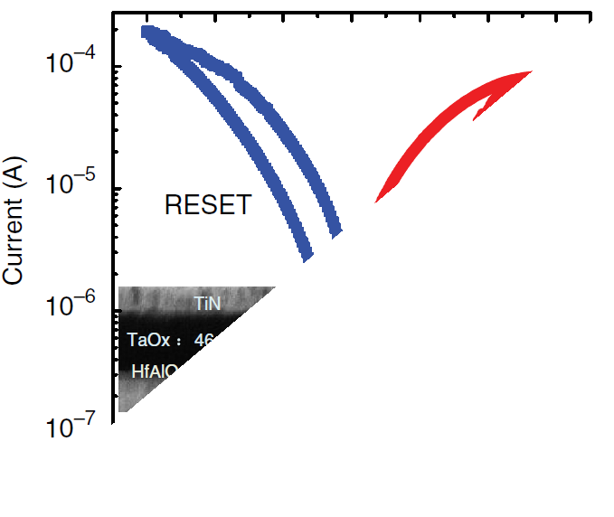
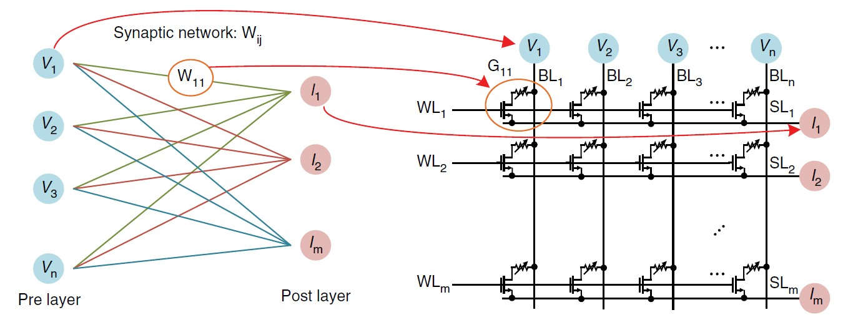
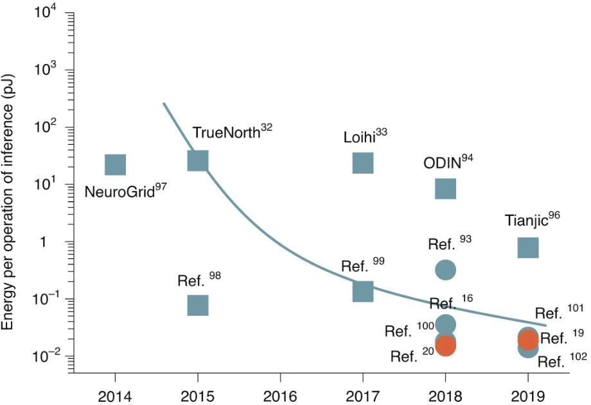
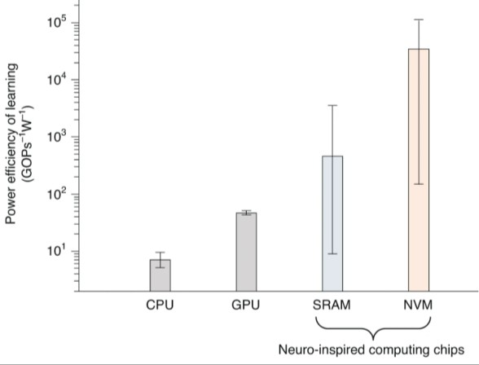
Future Trend: Emerging Non-Volatile Memories
Resistive RAM (RRAM)
Data from Prof. H.Q Wu’s group @ Tsinghua University

Slide 15



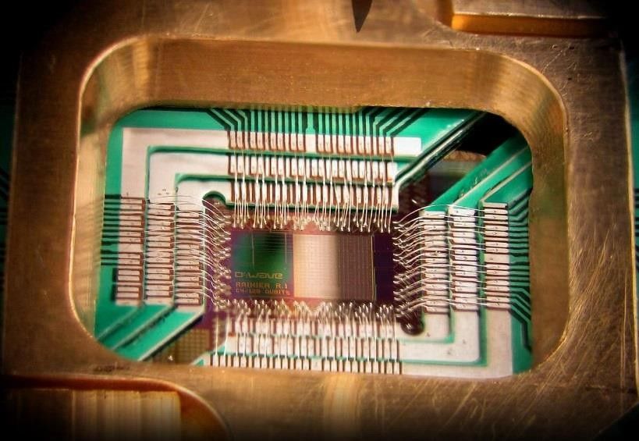
Future Trend: Quantum Computing
Feb. 2014 TIME
The Infinity Machine
https://www.dwavesys.com/
128 superconducting logic elements

Slide 16


